Slide 1
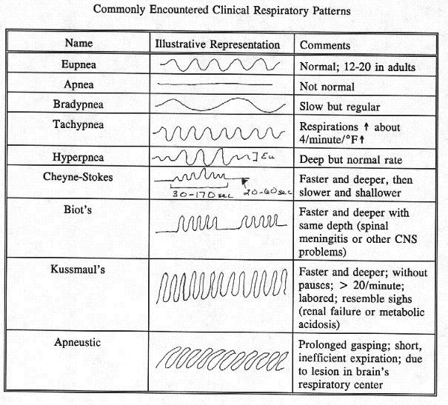

Slide 2
Paradoxic |  | Portion or all of the chest moves in with inhale and out with exhale
Hyperpnea |  | Increased breathing, ↑ Vt and/or ↑frequency
Hypopnea |  | Decreased breathing, ↓Vt and/or ↓frequency
Gasping |  | Spasmodic insp. effort, usually deep, brief and ending quickly
Agonal |  | Shallow, irregular insp. followed by irregular periods of apnea
Dyspnea |  | Subjective difficult or labored breathing
Orthopnea |  | Dyspnea while lying flat, relieved when upright

